Slide 1
Build a Better Student
Build a Better Teacher
Revolutions in Teaching Physics
Chris Meyer
York Mills C. I., Toronto
www.meyercreations.com/physics
Notes:
Thanks for having me here …
It is wonderful to have this opportunity to share with you my story about what I have learned about teaching and physics. I would like to begin by discussing some career advice. What do you do with a physics training?

Slide 2
You’ve just finished your physics training …

Slide 3
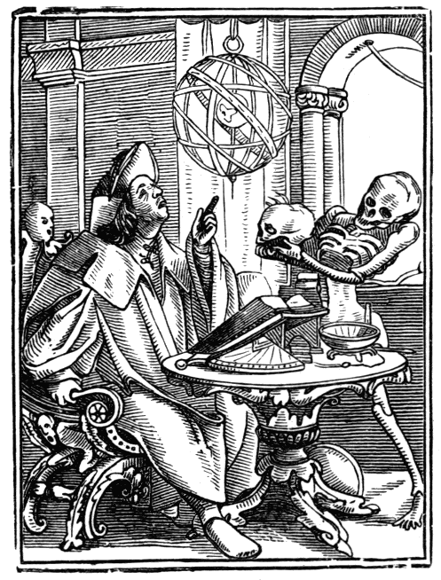
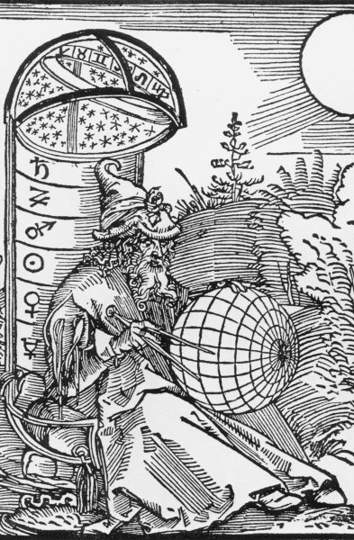
Casting Fortunes
The Dance of Death/Astrologer,
Hans Holbein, 1524
The Astrologer, Albrecht Durer, 1498
Notes:
A person could make a decent buck by their ability to divine the future through the examination of the heavens. Folk would gasp with wonder and marvel at your extraordinary abilities.

Slide 4
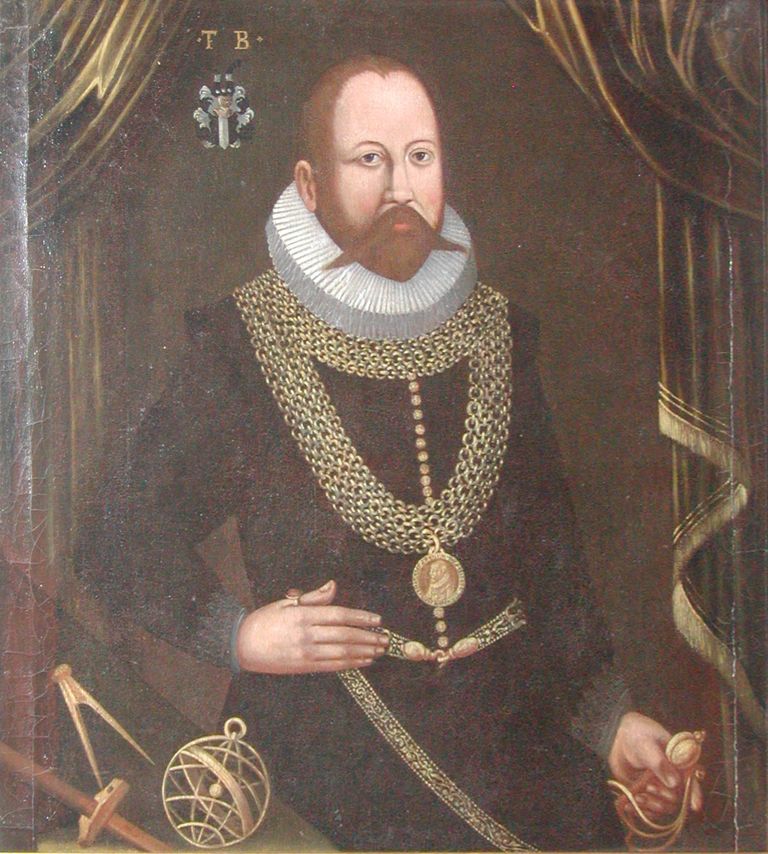
Tycho Brahe
Notes:
These were not all quacks and kooks. This was a learned occupation! Some were great scientific minds.

Slide 5
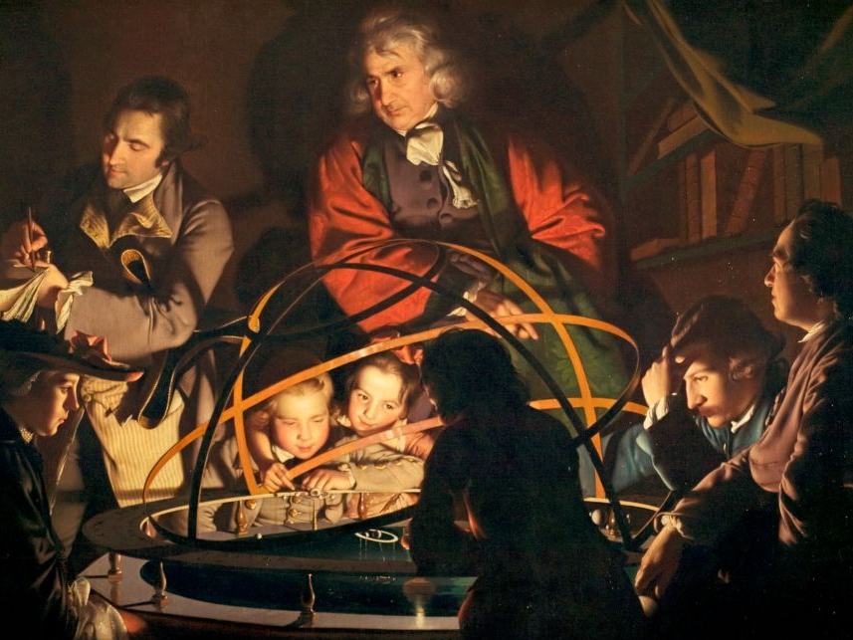
Scientific Revolution
A Philosopher giving a Lecture on the Orrery in which a lamp is put in place of the Sun,
Joseph Wright of Derby, 1766
Notes:
Along came the scientific revolution and put the kibosh on that. The heavens were liberated from superstition! The sobriety of empiricism swept the astrologers out of the academy.

Slide 6
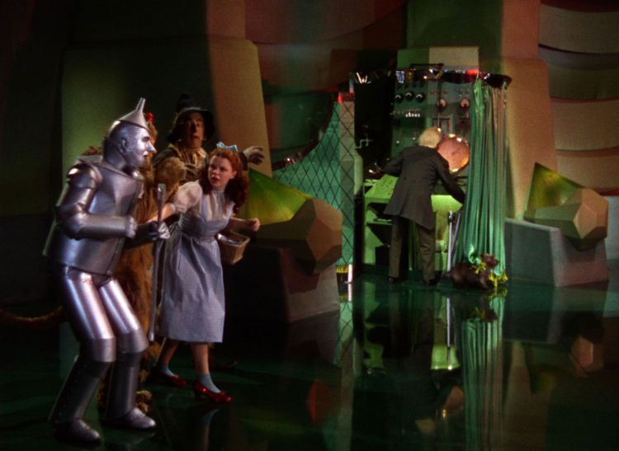
Sobriety of Empiricism
Notes:
Because the curtain of magic and wonder was pulled back, the diviner’s powers as much as they were persuasive, were revealed to be illusory. So what to do next with your physics training?

Slide 7
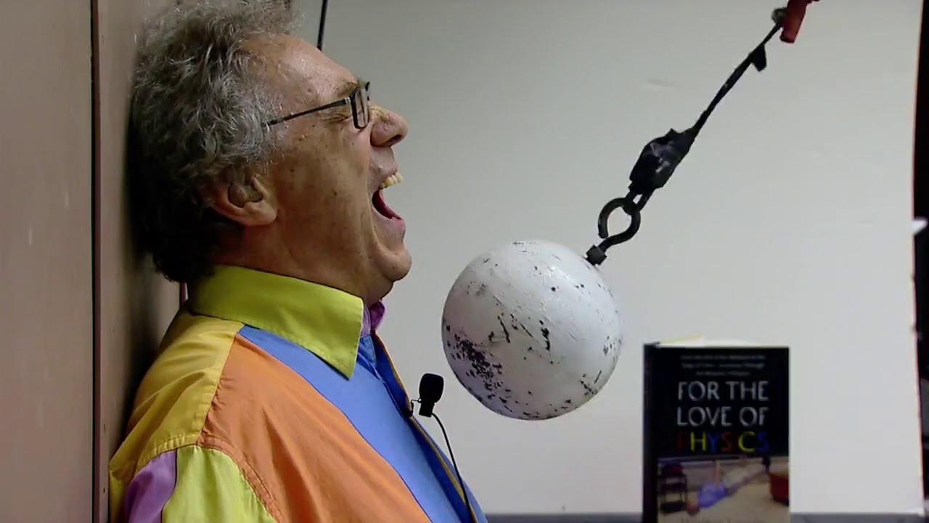
“The Noble Profession”: Teaching
Notes:
How about teaching? This is the bread and butter for many of us.

Slide 8
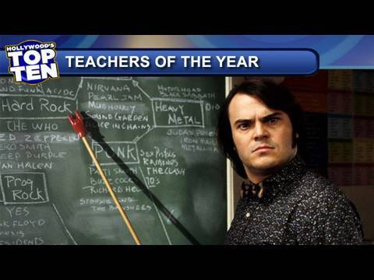
Great Teachers
Notes:
Some teachers also have a mystical ability to spellbind and enthrall. To dazzle and inspire and make a deep emotional connection with people. Some have a great ability to …

Slide 9
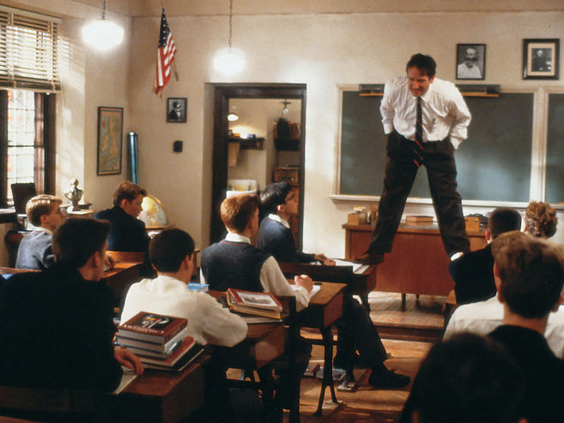
Great Teachers
Notes:
stand on tables. You know someone’s really teaching when …
But wherein lies their power? How far does the power of the charismatic teacher extend?

Slide 10
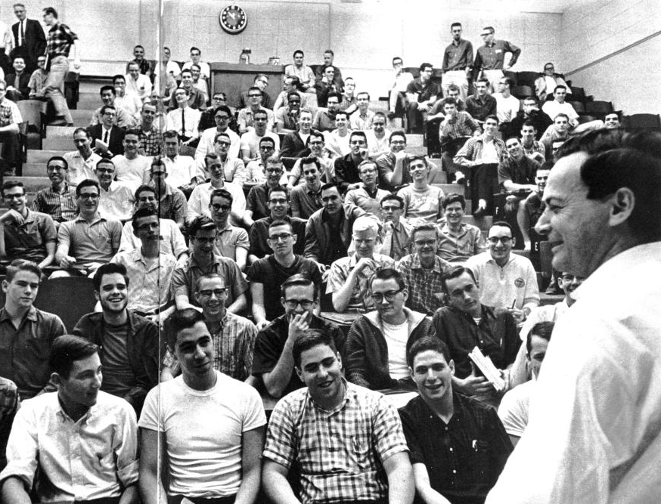
Feynman at Caltech
Notes:
Richard Feynman is widely regarded as having been an extraordinary teacher. His lecture halls at Caltech when he taught introductory physics were packed

Slide 11
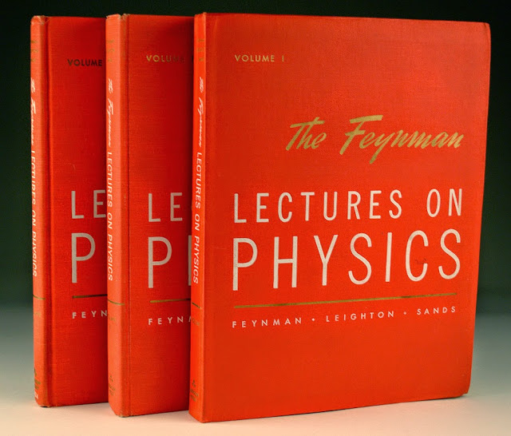
Notes:
and his lectures have become legend. But Feynman was confronted with the limits of his Magical powers. As many of you might well know, reality cuts deepest when reviewing final exam results. He remarked that amongst the many disappointing exam papers:

Slide 12
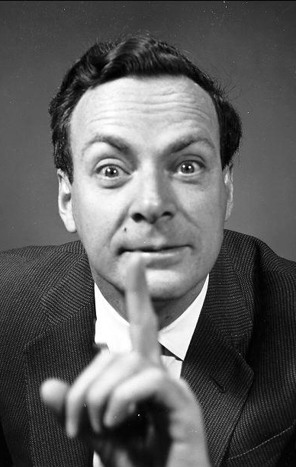
“… When I look at the examinations,
I think that
the system is a failure.”

Slide 13
“… there were
one or two dozen students who—very surprisingly—understood almost everything … and they are, after all, the ones I was trying to get at.”

Slide 14
How well is the material presented?
How well are students learning?
Notes:
The great teachers perform extraordinarily well, when judged by the question:
But how well do they perform when we ask a different, more scientific question?

Slide 15
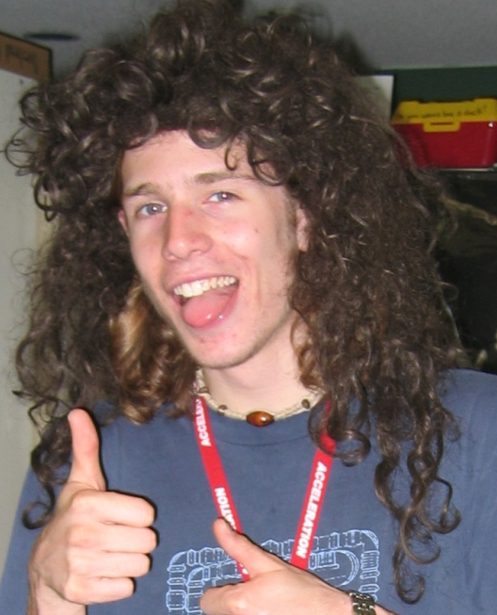
Distilled Physics Wisdom
?
Typical Student
Notes:
Let’s take a moment to think about what this question means. Take your typical physics student. When we do our best to share our hard-earned physics wisdom, and the question is: how much makes it in there? How do we figure this out?

Slide 16
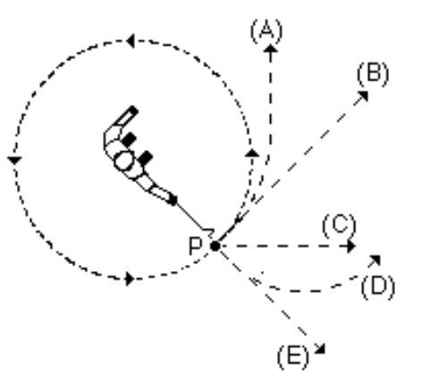
Question Time!
A ball on a string is swung in a horizontal circle.
At point P, the string breaks.
Which path would the ball most closely follow, observed from above?
A
B
C
D
E
Hestenes, D., Wells, M., & Swackhamer, G. (1992). Force concept inventory. The physics teacher, 30(3), 141-158.
Notes:
By creating an empirical test. The Force Concept Inventory …
The hallmark of these questions is that they do not involve any math.

Slide 17
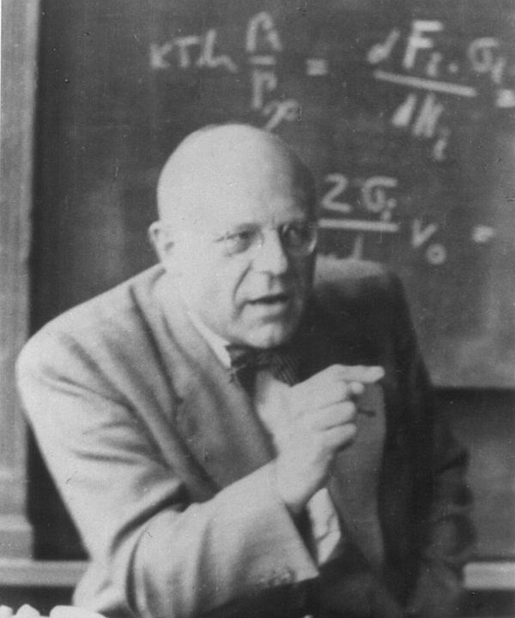
Way too easy!
Harrumph!
Notes:
And if you give them to a cranky expert, they will growl with disdain:
But they provide a revolutionary window into our students understanding and the effectiveness of our instruction.

Slide 18
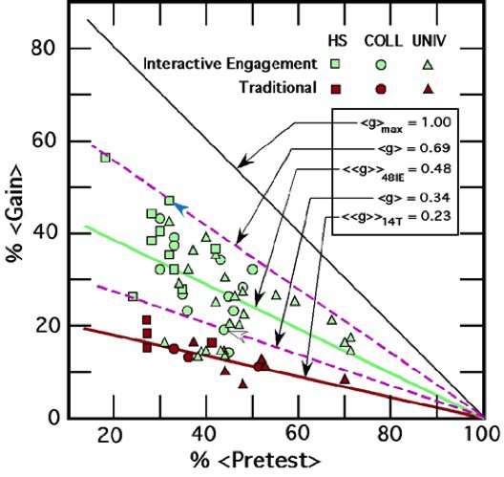
How Much Are Students Learning?
Force Concept Inventory
Traditional Instruction
Normalized Learning Gain
= 23%
Hake, Richard R. "Interactive-engagement versus traditional methods: A six-thousand-student survey of mechanics test data for introductory physics courses." American journal of Physics 66.1 (1998): 64-74.
Notes:
As revealed by a massive meta-study, traditional lecture-based instruction has a distinct cut-off in effectiveness, regardless of the quality of instructor. .... Red shapes ….
Learning gain is a measure of ….

Slide 19
Distilled Physics Wisdom
23%
77% Scattered
Typical Student
Notes:
So now we have an answer: how much do students improve under the benefit of out wisdom?
And what happens to the rest? Why didn’t our carefully crafted wisdom stick?

Slide 20
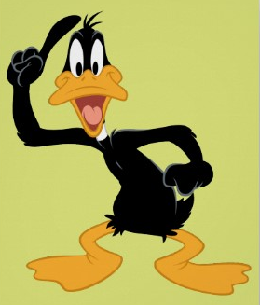

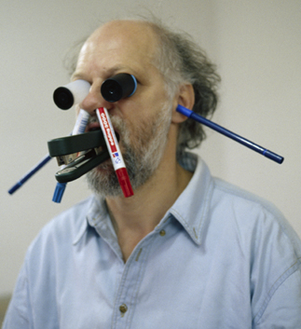
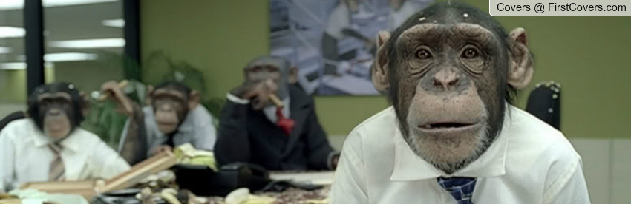
Best Lesson Ever
Notes:
All of us teachers have long sensed that this was the case. We have all had the experience …

Slide 21
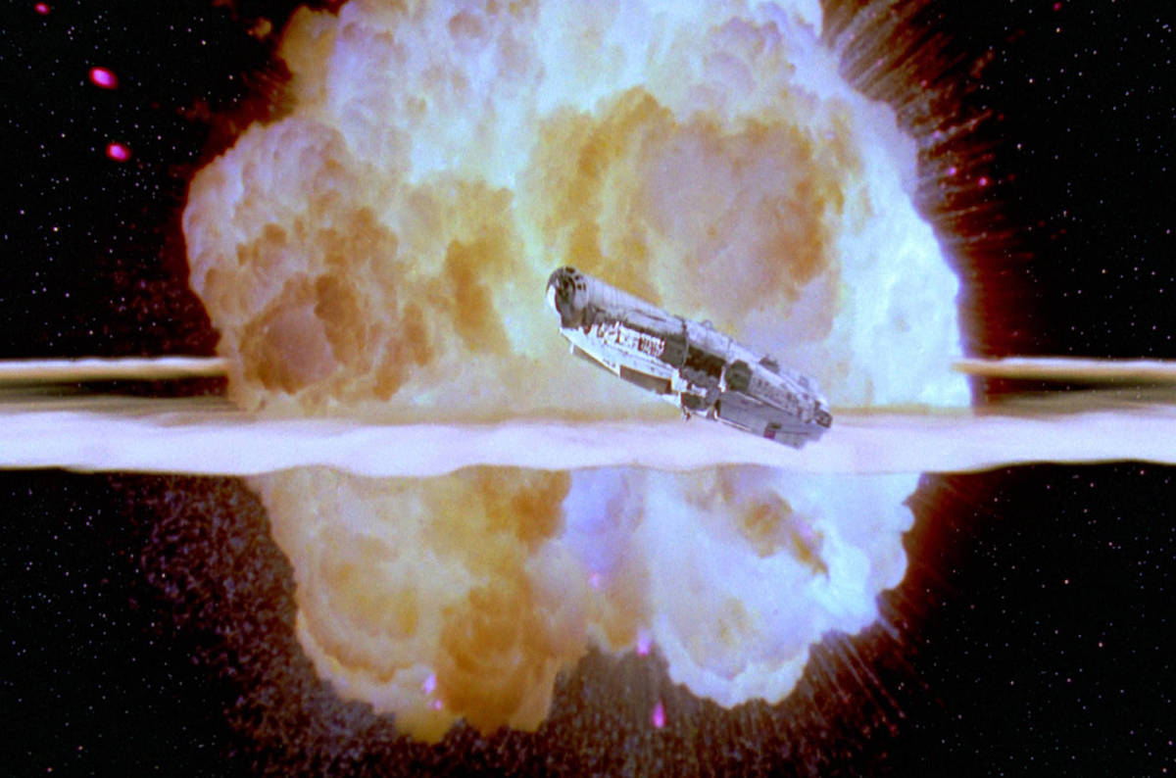
Notes:
And they bomb it in epic style.

Slide 22
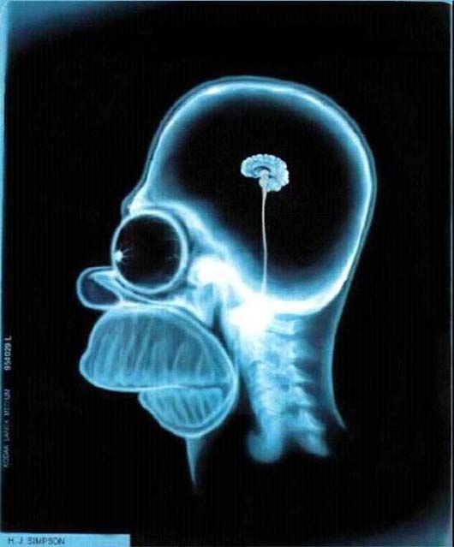
What’s Going on Upstairs?
Notes:
While we are left wondering:
… how did I get stuck teaching this course and when can I get back to my research.

Slide 23
A Scientific Revolution for Teaching
A Philosopher giving a Lecture on the Orrery in which a lamp is put in place of the Sun,
Joseph Wright of Derby, 1766
Notes:
The FCI was part of the early wave of research that began to transform teaching into an empirical science. Almost thirty years later, we are in the midst of a full scientific revolution for teaching. The excitement and great potential of this is what brings me here today. When we harness the powers of science, we can replace our instinctual reactions to our students’ learning difficulties:

Slide 24
How well is the material presented?
(internal logical consistency = Aristotle)
How well are students learning?
(what are the actual results = Galileo)
Notes:
The great teachers perform extraordinarily well, when judged by the question:
But how well do they perform when we ask a different, more scientific question?

Slide 25
What’s Going on Upstairs?
WTF?
Notes:
While we are left wondering:
… how did I get stuck teaching this course and when can I get back to my research.

Slide 26
What happens in students’ brains when they learn?
Notes:
With clear scientific questions to answer.

Slide 27
What happens in students’ brains when they learn?
Research
Scientific
Model of Learning
Curriculum Development
Instruction
Notes:
With clear scientific questions to answer.

Slide 28
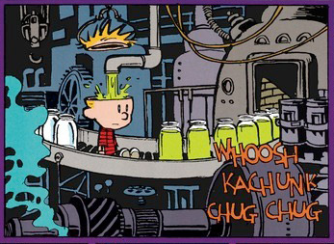
Learning Model #1
Feynman Lectures
Tight Seal
Notes:
Here is one very common model for learning….
We just have to figure out the right stuff to poor in, screw on the lid tightly (maybe that was our problem … ) and, voila!

Slide 29
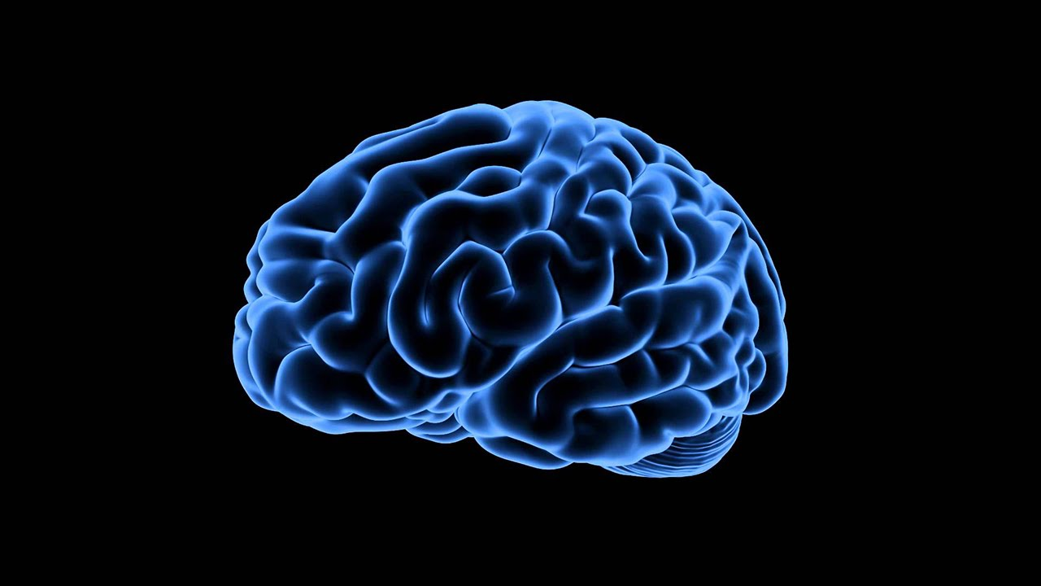
Learning Model #2
Cognitive Resource Model
DiSessa, A. A. (1993). Toward an epistemology of physics. Cognition and instruction, 10(2-3), 105-225.
Notes:
Smallest units of knowledge = “cognitive resources”
seem true from everyday experience, do not need further explanation, “just the way the world is”
Based on personal experiences in our world

Slide 30
Knowledge is built from primitive pieces
Increased resistance = less result
Force moves objects
Stronger influence wins
DiSessa, A. A. (1993). Toward an epistemology of physics. Cognition and instruction, 10(2-3), 105-225.
Notes:
Smallest units of knowledge = “cognitive resources”
seem true from everyday experience, do not need further explanation, “just the way the world is”
Based on personal experiences in our world

Slide 31
As we learn, connections grow
Increased resistance = less result
Force moves objects
Stronger influence wins
Notes:
- As we learn connections grow or become more numerous

Slide 32
Networks of cognitive resources form
Force spins
Force deflects
Heavy things resist
R ↑, motion ↓
Motion dies away
Opposites cancel
F ∴ motion
Change takes time
Stronger wins
Objects squish with force
More effort = more resistance
Notes:
Complex networks form, connecting numerous cognitive resources
Each network is unique to the individual.

Slide 33
Testing Models: Observations
Find the current
through the 2 ohm resistor and the potential difference between point a and b.
75%
Average =
Notes:
A few examples to help us compare the explanatory power of these two models.

Slide 34
Testing Models: Observations
When the switch is closed,
what happens to:
(a) the current through the battery
(b) the brightness of the bulbs
40%
Average =
Notes:
We cover this material …. Why does this happen.

Slide 35
How Do We Explain This?
“Passive Vessel”
Cognitive Resources
Force spins
Force deflects
Heavy things resist
R ↑, motion ↓
Motion dies away
Opposites cancel
F ∴ motion
Change takes time
Stronger wins
Objects squish with force
More effort = more resistance
Learning Model #1
Learning Model #2
Notes:
Here is one very common model for learning….
We just have to figure out the right stuff to poor in, screw on the lid tightly (maybe that was our problem … ) and, voila!

Slide 36
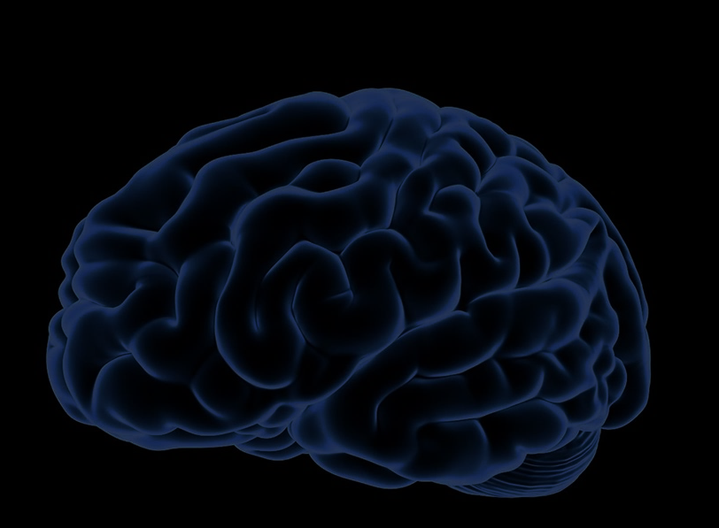
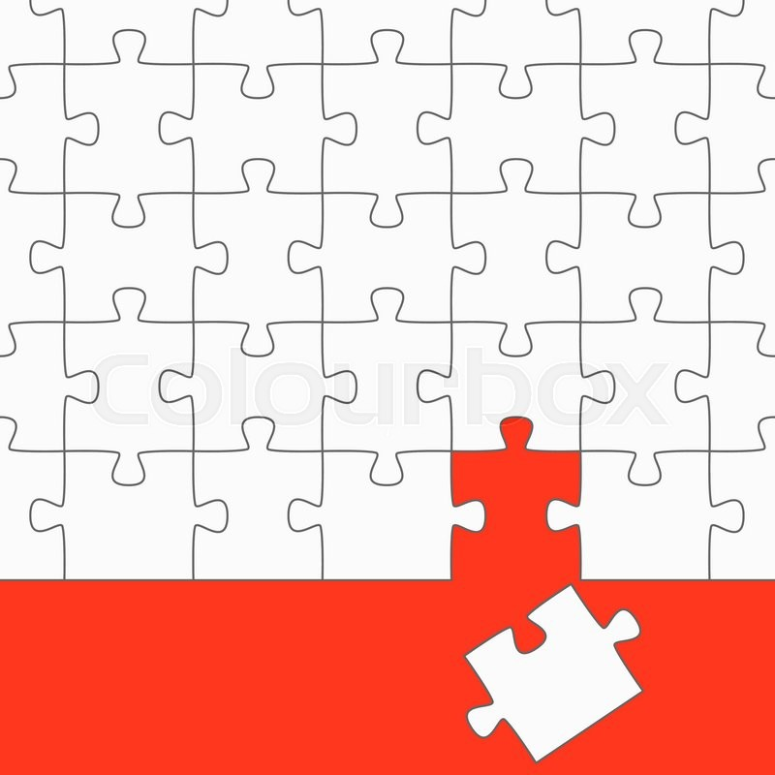
Wiring Problem
We make sense of new ideas by making connections to pre-existing ideas.
If pre-existing ideas
are not ready, students
cannot make use
of expert knowledge.
Notes:
The final piece of this model reminds us that …
This is the opposite of the empty vessel idea …

Slide 37
Instructional Challenge
Students arrive in our classes with their brains prewired based on their life experiences
and prior schooling.
Educators must understand these initial conditions
to successfully teach
for students to learn.
Notes:
The final piece of this model reminds us that …
This is the opposite of the empty vessel idea …

Slide 38
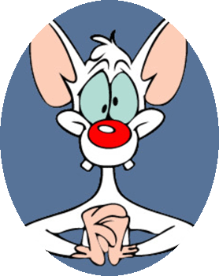
The Novice
Scientific knowledge fragmented
Little context
Unique configuration
Fewer useful “hooks” to attach new ideas
Force spins
Force deflects
Heavy things resist
R ↑, motion ↓
Motion dies away
Opposites cancel
F → motion
Change takes time
Stronger wins
Objects squish with force
More effort = more resistance
Notes:
So let’s peer into to the novice brain and see what’s happened.
We find fragmented knowledge resources with little connection to context or to ideas that help them decide when the knowledge is useful or relevant. As a result, they tend to grasp at surface features and fail to penetrate to the core ideas.

Slide 39
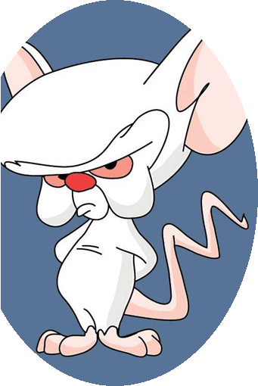
The Expert
Rich webs of connections
Highly contextual
See “big picture”
Fluent / invisible skills
Force spins
Force deflects
Heavy things resist
R ↑, motion ↓
Motion dies away
Opposites cancel
F → motion
Change takes time
Stronger wins
Objects squish with force
More effort = more resistance
Notes:
The expert brain has numerous connections between knowledge resources that are tightly bound to context and conditions of use. Rapidly see deeper ideas at work.

Slide 40
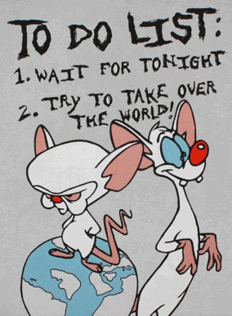
Educational Goal
Notes:
To clarify Wieman’s goal, we want to transform the novice into an expert... And.....

Slide 41
Teaching is a Wiring Problem
Force spins
Force deflects
Heavy things resist
R ↑, motion ↓
Motion dies away
Opposites cancel
F → motion
Change takes time
Stronger wins
Objects squish with force
More effort = more resistance
Notes:
At a deeper level, or educational goal translated into wiring – we want to rewire or students brains!

Slide 42
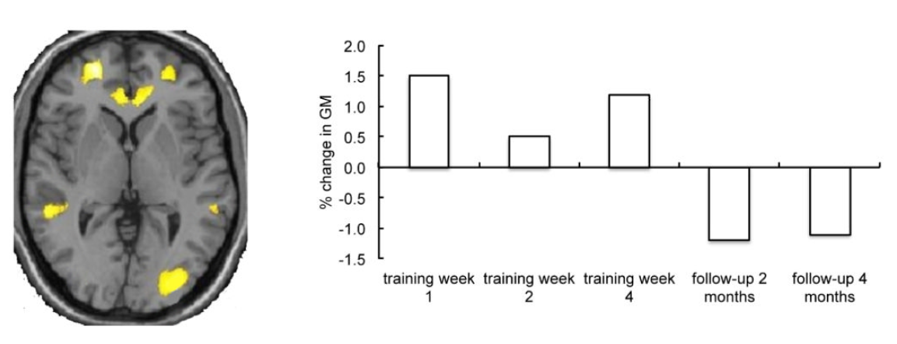
Wiring is a Physical Process
Zatorre, R. J., Fields, R. D., & Johansen-Berg, H. (2012). Plasticity in gray and white: neuroimaging changes in brain structure during learning. Nature neuroscience, 15(4), 528-536.
Notes:
This is exciting! Because we now understand that learning is a physical process and not hocus pocus. And who is awesome with physical processes? Recent results from neuroscience have shown some of the first tantalising evidence for the growth of brain tissue in response to learning ... And... The shrinking of tissue as a result of disuse.

Slide 43
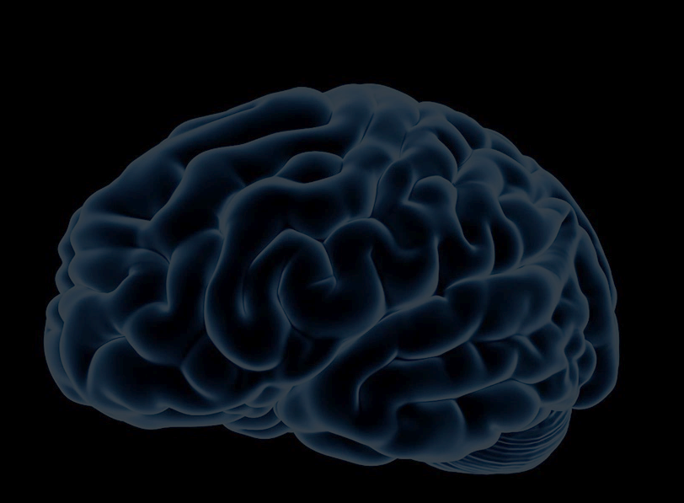
Learning = Wiring
Wiring = Physical Process
Learning = Physics!

Slide 44

How to rewire a student brain?
We can’t!
Only the student can.

Slide 45
Instructional Goal
Create a learning environment that gives students the opportunity to create connections themselves.
Notes:
Now we can ask the question: “What should our instruction accomplish?” What type of experiences promote the re-wiring our students’ need?

Slide 46
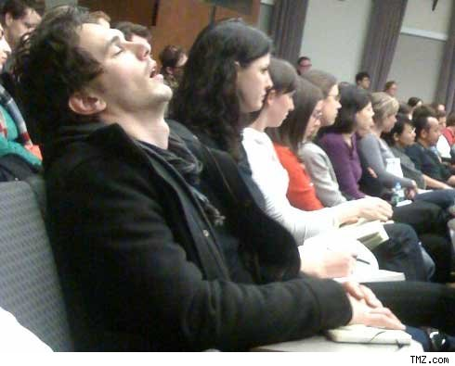
What Environment Doesn’t?
James Franco @ Columbia University
Notes:
We can be pretty sure what doesn’t promote learning.

Slide 47
Measure Expert-Like Attitudes
Colorado Learning Attitudes About Science Survey (CLASS)
“When I am solving a physics problem, I try to decide what would be a reasonable value for the answer.”
“I think about the physics I experience in everyday life.”
Adams, W. K. et al. (2006). New instrument for measuring student beliefs about physics and learning physics: The Colorado Learning Attitudes about Science Survey. Physical Review Special Topics-Physics Education Research, 2(1), 010101.
Notes:
An important part of expertise is the set of attitudes that physicists have towards the process of learning and doing physics. Researchers have developed told to help us measure the development of expert like attitude in our classroom by asking some simple questions:
If we survey Students at the beginning and end of a course, we can measure how those attitudes change.
The results are even more surprising then the FCI.

Slide 48
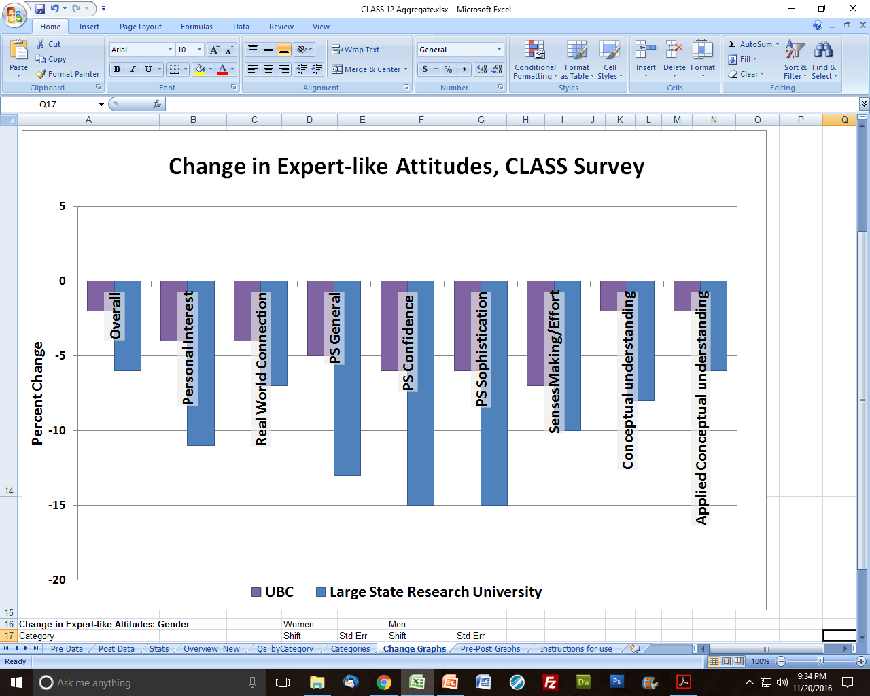
Measure Expert-Like Attitudes
Milner-Bolotin, M., Antimirova, T., Noack, A., & Petrov, A. (2011). Attitudes about science and conceptual physics learning in university introductory physics courses. Physical Review Special Topics-Physics Education Research, 7(2), 020107.
Notes:
Typical instruction usually causes a significant negative shift in attitudes across a range of attitudes.
Undergrad chair? Take note!

Slide 49
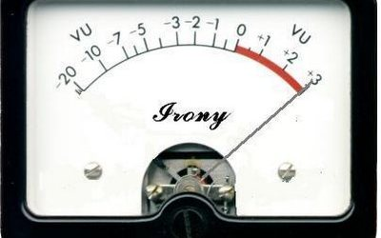
Notes:
Just to clarify: lecture is good as transmitting information, but very poor at promoting deep understanding.

Slide 50
Cognitive Learning Cycle
Premotor and Motor
Sensory and Postsensory
Frontal Integrative Cortex
Temporal Integrative Cortex
Zull, J. The Art of Changing the Brain. 2002

Slide 51
Cognitive Learning Cycle
Do
Input
Plan
Assign Meaning
Zull, J. The Art of Changing the Brain. 2002

Slide 52
Cognitive Learning Cycle
Active Testing
Concrete Experience
Abstract Hypotheses
Reflective Observation
Zull, J. The Art of Changing the Brain. 2002

Slide 53
Which parts of the cycle does traditional instruction focus on?
Active Testing
Concrete Experience
Abstract Hypotheses
Reflective Observation
Zull, J. The Art of Changing the Brain. 2002

Slide 54
Learning Model #1 Behaviours
Traditional Student Work
Traditional Instruction
Active Testing
Little Active Testing
Lots of Input!
Concrete Experience
Abstract Hypotheses
Lots of Math Work!
Little Reflection to Assign Meaning
Reflective Observation
Zull, J. The Art of Changing the Brain. 2002

Slide 55
Learning Model #2 Behaviours
Active Testing
Discuss / Gesture
New Ideas with Context
Concrete Experience
Abstract Hypotheses
Process Ideas / Predict
Interpret Scenario
Reflective Observation
Zull, J. The Art of Changing the Brain. 2002

Slide 56
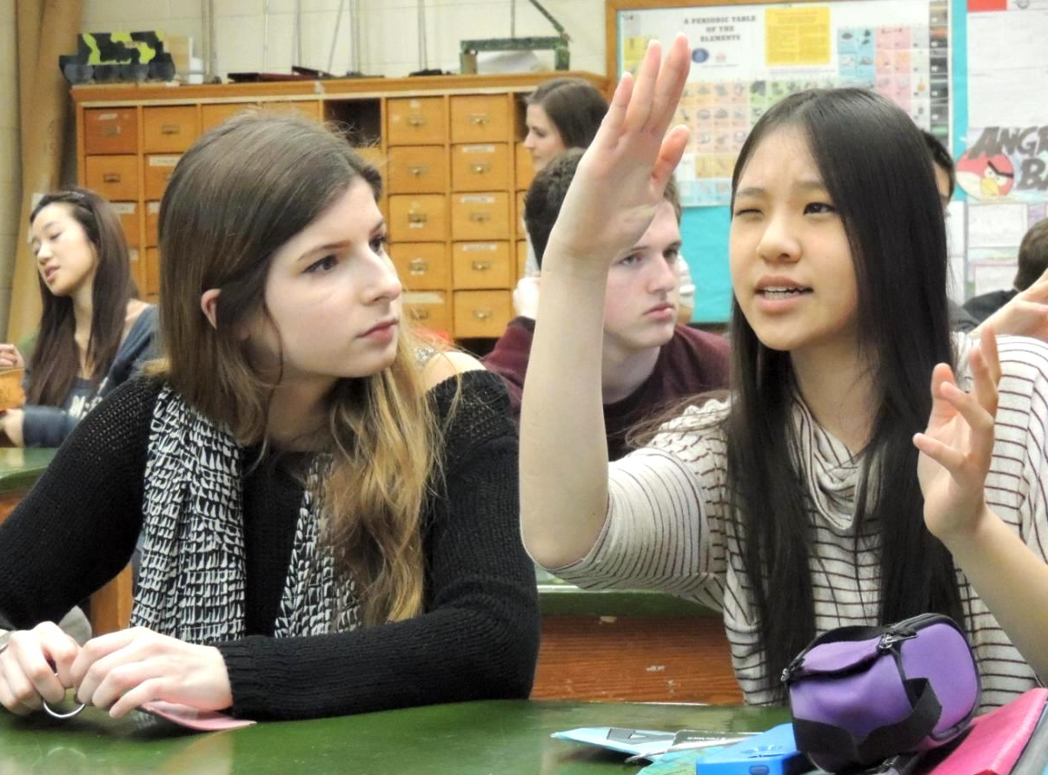
Active Learning
Notes:
This is the game changer!

Slide 57
Active Learning
Involves activities and/or discussion
Emphasizes higher-order thinking and often involves group work.
Humans learn best through social interactions!
Freeman, Scott, et al. "Active learning increases student performance in science, engineering, and mathematics." Proceedings of the National Academy of Sciences (2014): 201319030.
Notes:
This is the game changer!

Slide 58
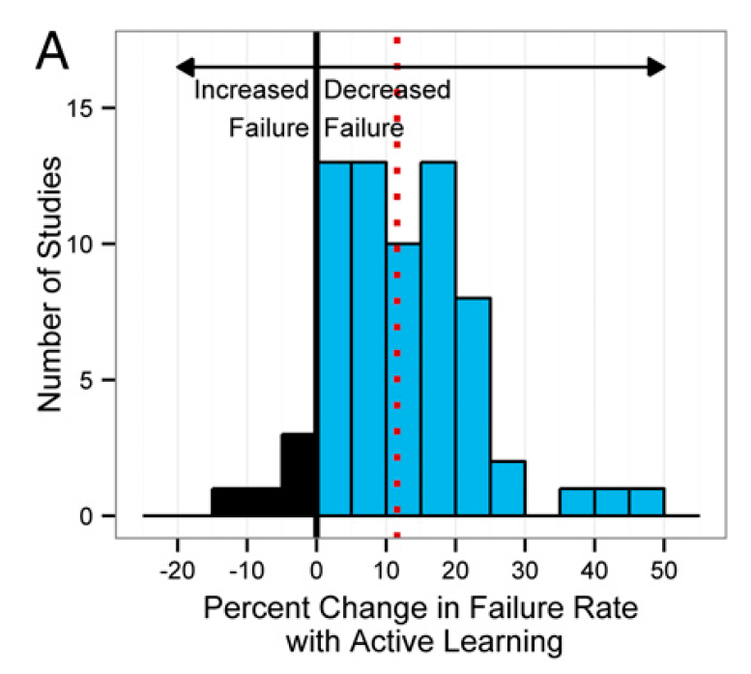
Freeman, Scott, et al. "Active learning increases student performance in science, engineering, and mathematics." Proceedings of the National Academy of Sciences (2014): 201319030.
Notes:
A massive meta-study comparing active learning to traditional instruction across many STEM disciplines shows a significant decrease in the failure rate

Slide 59
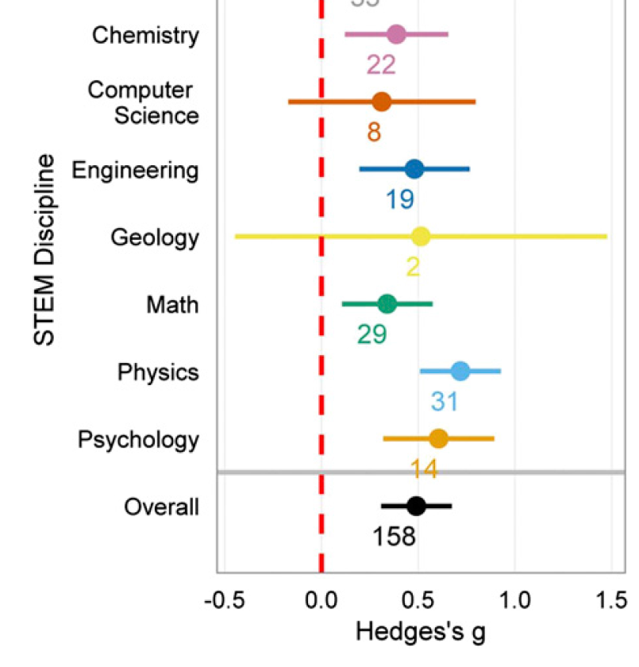
Improved Course Performance
Notes:
A significant increase in performance on exams or conceptual surveys … and hey! Look at physics leading the pack with improvements of ¾ of a standard deviation.

Slide 60
Active Learning Works
Active Learning
Normalized Gain = 48%
Notes:
Now we see the complete picture and the power of active learning. The shapes in green are …
Active learning doubles the improvements our students make due to instruction. Twice as much education for the price of one degree. Incredible!

Slide 61
Build a Better Student
Build a Better Teacher
Research-based
practices produce
Better Teachers
and Better Students
Notes:
With a scientific approach to teaching and learning, we can literally …

Slide 62
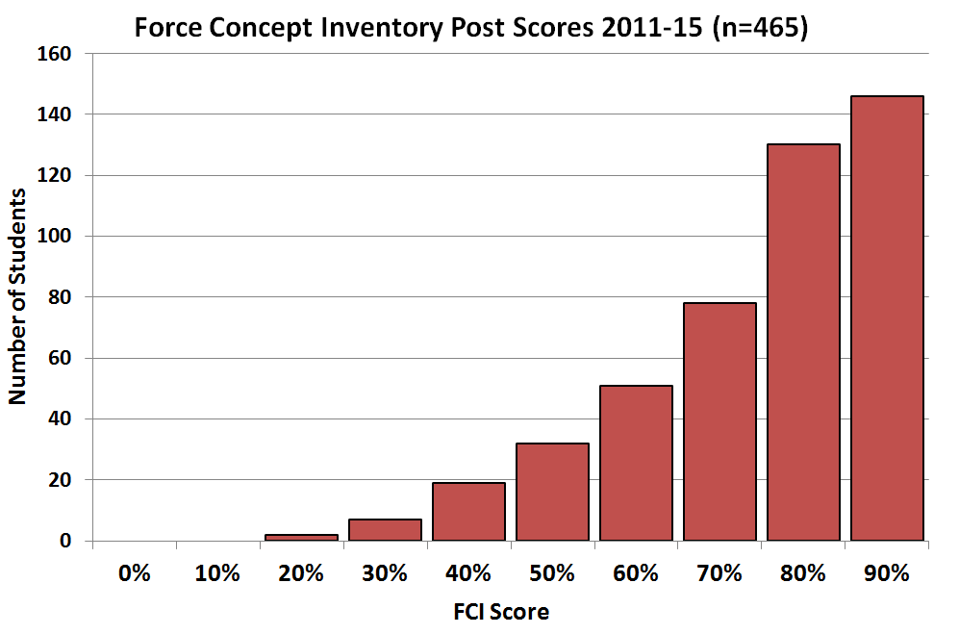
Build a Better Teacher
York Mills Mean = 81.5% ± 0.7%
Toronto High School = 73%
Ottawa High School = 79%
Average PreMed student starting Harvard
= 70%
Average student with gr. 12 physics starting U of T
= 57%
Average student with gr. 12 physics starting Ryerson
= 39%
Notes:
By creating a well-designed, research-informed program, average teachers can produce results that our best teachers a generation ago could only dream of.

Slide 63
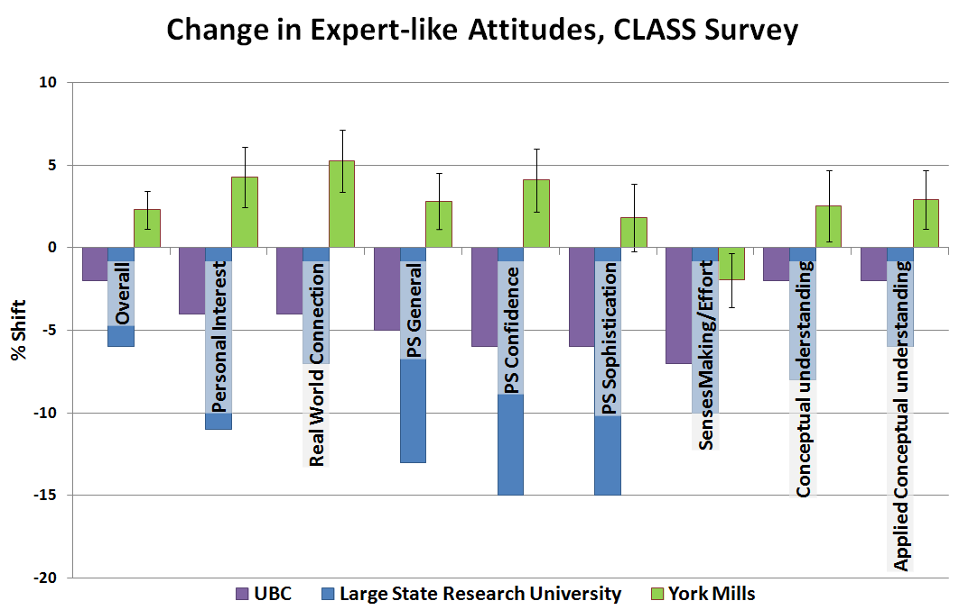
Build a Better Student
Notes:
Reformed teaching can help students develop expert-like attitudes towards learning and …

Slide 64
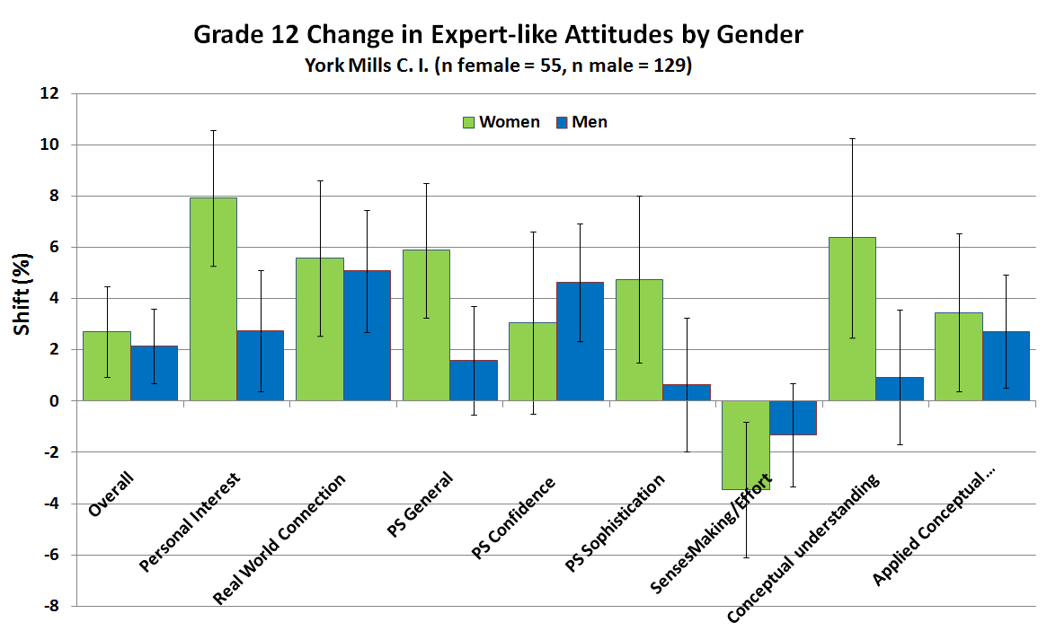
Build a Better Student
Notes:
Encourage under-represented communities of people to appreciate the majesty of the physical universe and the rewards of the physics profession.

Slide 65
The Challenges of Change
Experience and Time
Notes:
(1) Our knowledge is not in a useful form, (2) our classes must provide students with time to explore ideas, (3) no matter how mathematically sophisticated physics is, deep concepts and principles govern its operations

Slide 66
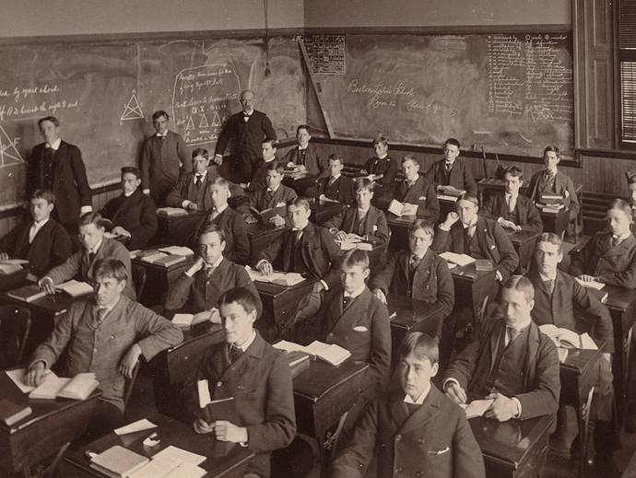
Experience
We were taught differently
We are not trained for a new way
We might not feel the need to change (“the old system worked to me!”)

Slide 67
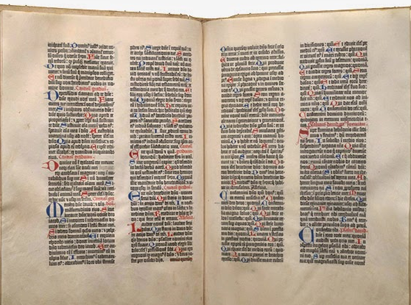
Time
So much content!
Cover less, but do it well
I have no time!
Don’t do it all at once
Don’t do it all yourself
Biblia latina (Bible in Latin). Mainz: Johann Gutenberg, 1455.
Otto Vollbehr Collection, Library of Congress (01.17.00)
Notes:
There is one technology that, more than any other, has the potential to disrupt the educational system and leave it staggering for a clear response. The printed book.

Slide 68
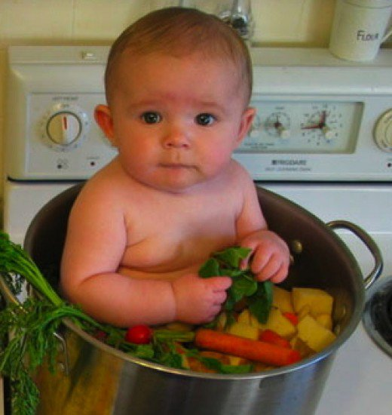
A 100% Satire-Free Modest Proposal
PHYS*4001/2 Research in Physics
Allow education as a research topic

Slide 69
Win-Win Deal
You need help / time
Senior students need apprenticeship in teaching and learning
Use PHYS*4001/2 to:
Summarize relevant literature
Observe classes / interview students
Study problem set / exam results
Design lesson ideas to try

Slide 70
The Benefits of Change
The Health of the Physics Community

Slide 71
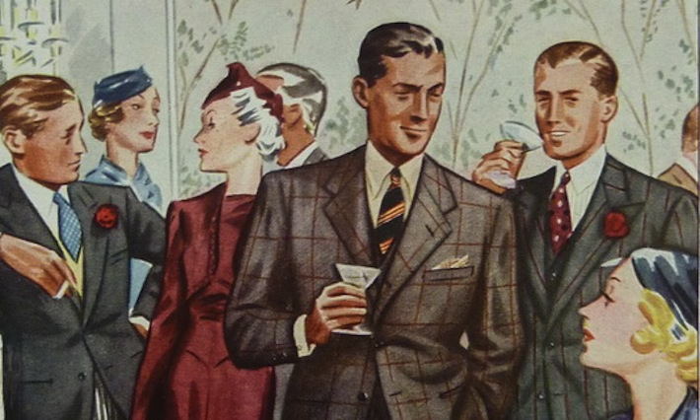
The Cocktail Party
Wow, physics, eh?
Physics was my worst subject.
Oh, I liked physics in school. But I didn’t do very well.
Notes:
You have probably had conversations like these:
And they look at you like a strange, other-worldly creature, like the astrologists and alchemists of old.
Largely because physics has an enduring reputation for:

Slide 72
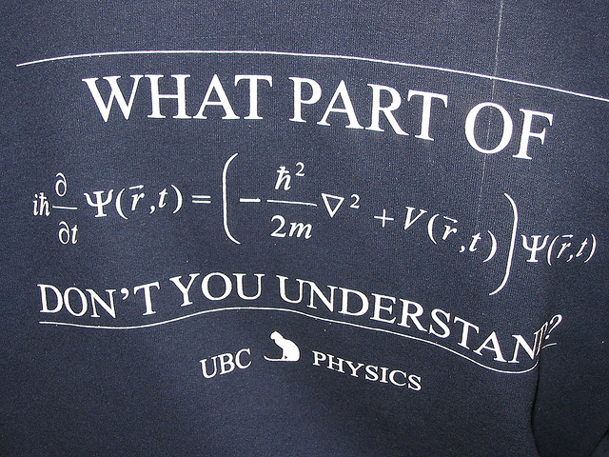
Physics is Hard
Notes:
Being hard.

Slide 73
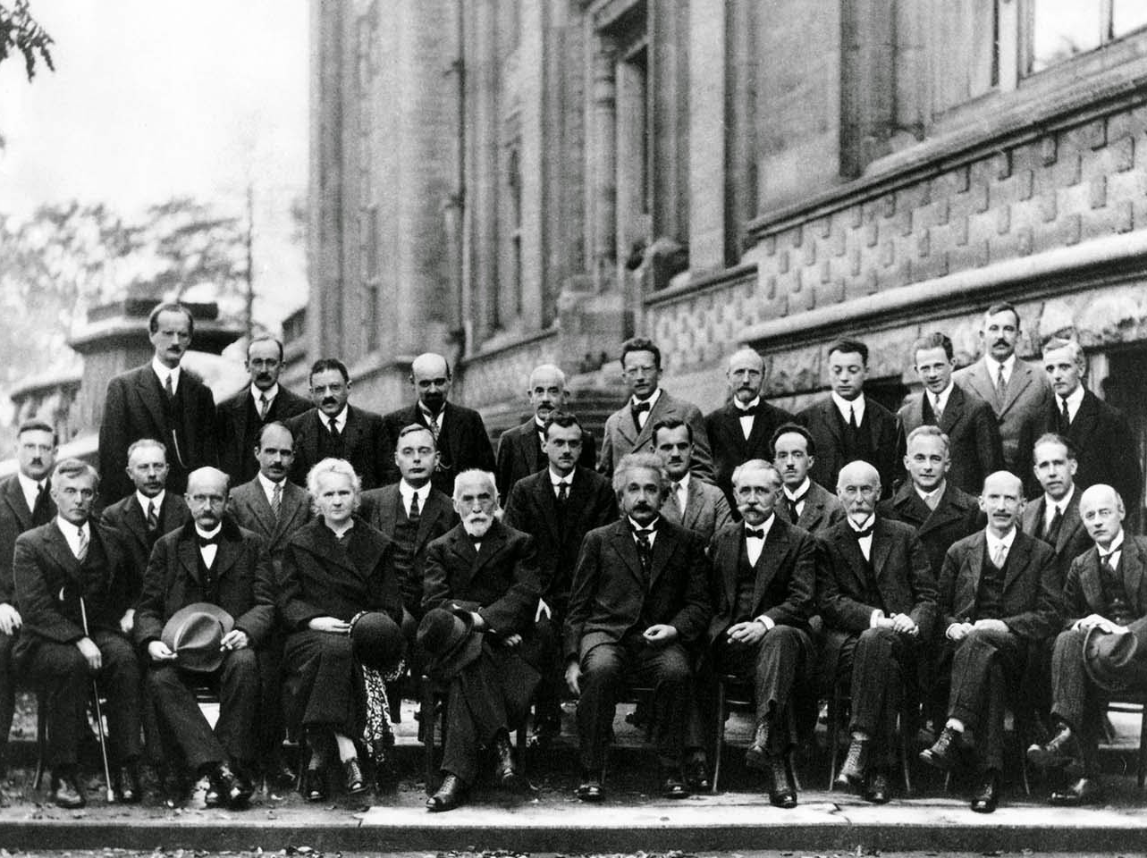
The Physics Community in 1927
What kind of people can do physics?
Notes:
This reputation and other factors has led people to construct a very narrow view of the strange and magical “people who can do physics”.

Slide 74
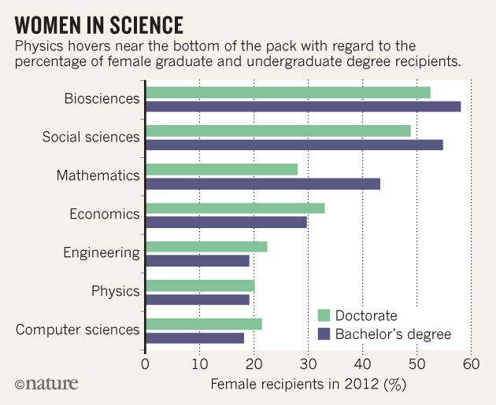
Notes:
We can see how powerful this effect is and the stunning lack of diversity it brings to this profession.

Slide 75
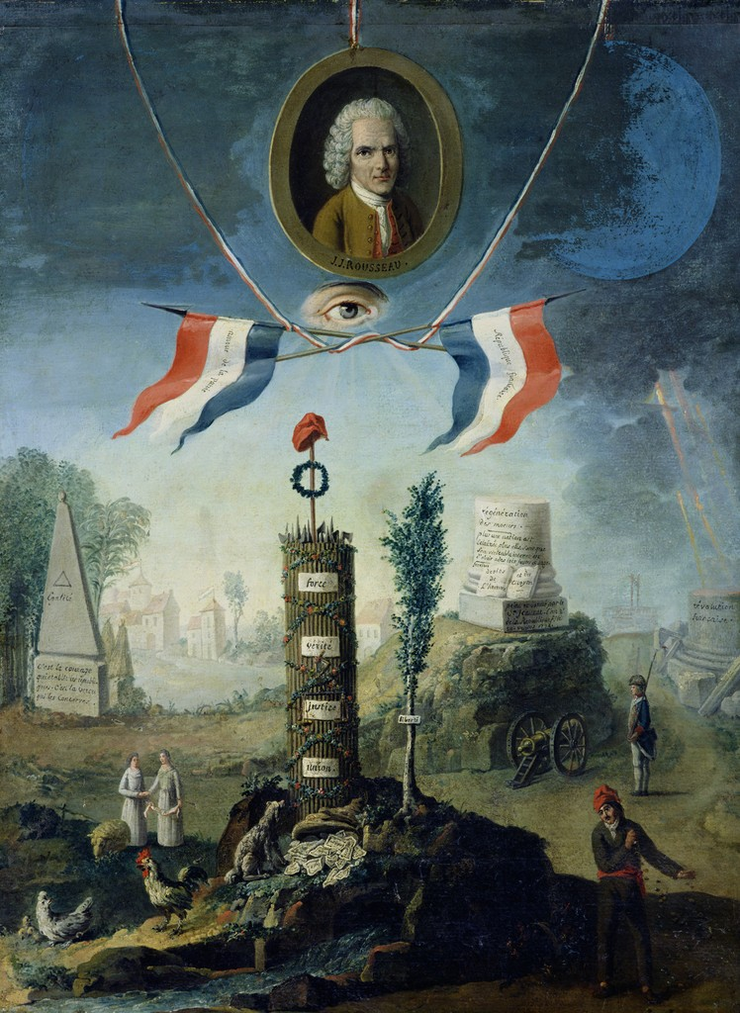
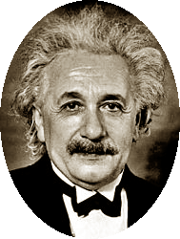
The Social Contract of Teaching
Teach Our Kids Well ...
An Allegory of the Revolution (1794),
Nicolas Henri Jeaurat de Bertry
Notes:
You might not recall signing this contract, but it exists and the legalese goes something like this:

Slide 76
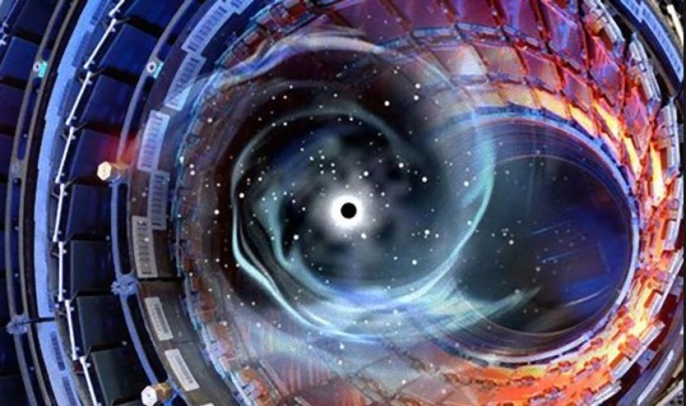
… Do Your Crazy Science Stuff
Notes:
The public asks that we:

Slide 77
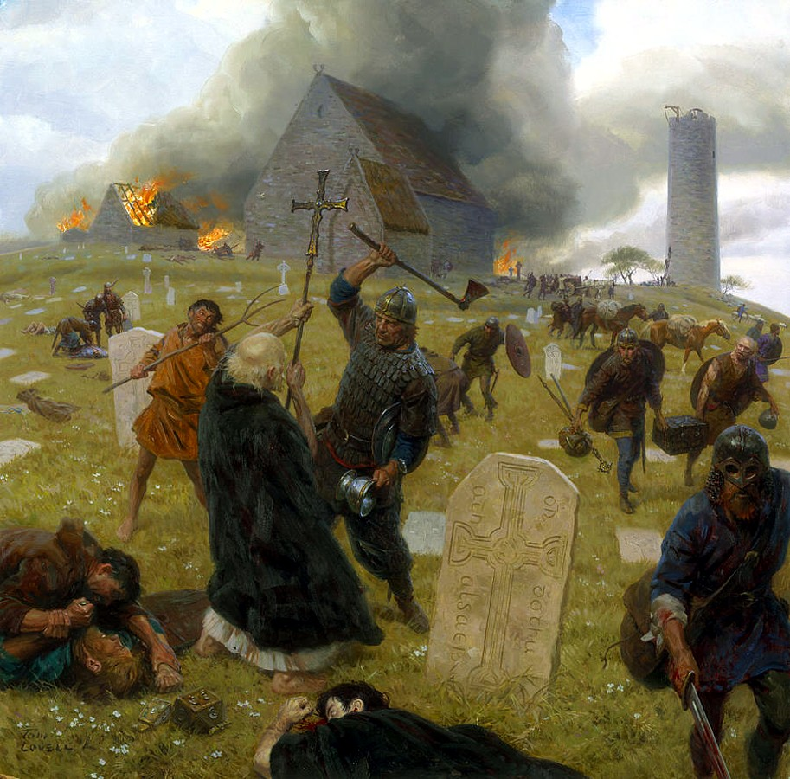
The Enlightenment Can Be Reversed
Notes:
We just need another government unfavourable to academic research …

Slide 78
Break the Spell of Experts
High level of training
Anders Ericsson, K., Roring, R. W., & Nandagopal, K. (2007). Giftedness and evidence for reproducibly superior performance: An account based on the expert performance framework. High Ability Studies, 18(1), 3-56.

Slide 79
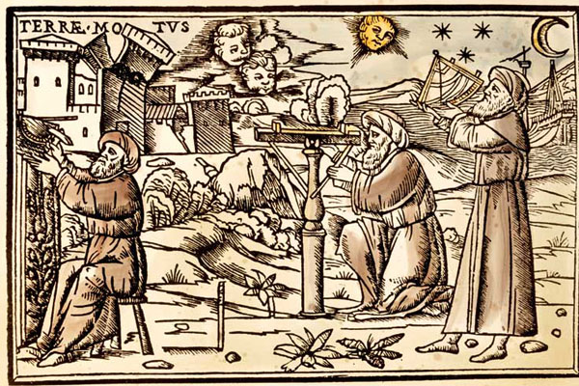
My Prediction
Physics education will improve to the point that any adult of average intelligence can be trained to become a well-regarded,
expert physicist.
Arabic Astronomers, 1513

Slide 80
A New Paradigm
In education,
what matters most is
what goes on
in a student’s head.
Notes:
Now we can ask the question: “What should our instruction accomplish?” What type of experiences promote the re-wiring our students’ need?

Slide 81
Join the Scientific Revolution for Teaching
Thanks!
www.meyercreations.com/physics
Notes:
I encourage you to join the …
with the hope that this will help start a new chapter in your teaching careers and also provide well-deserved bragging rights, so that you might tell your great-grandchildren, who will take this way of learning for granted, that you were part of the great teaching revolution of the first half of the 21st century.

